Slide 1
Step-by-Step Guide for Online
Meniscus Lesion Diagnosis System

Slide 2
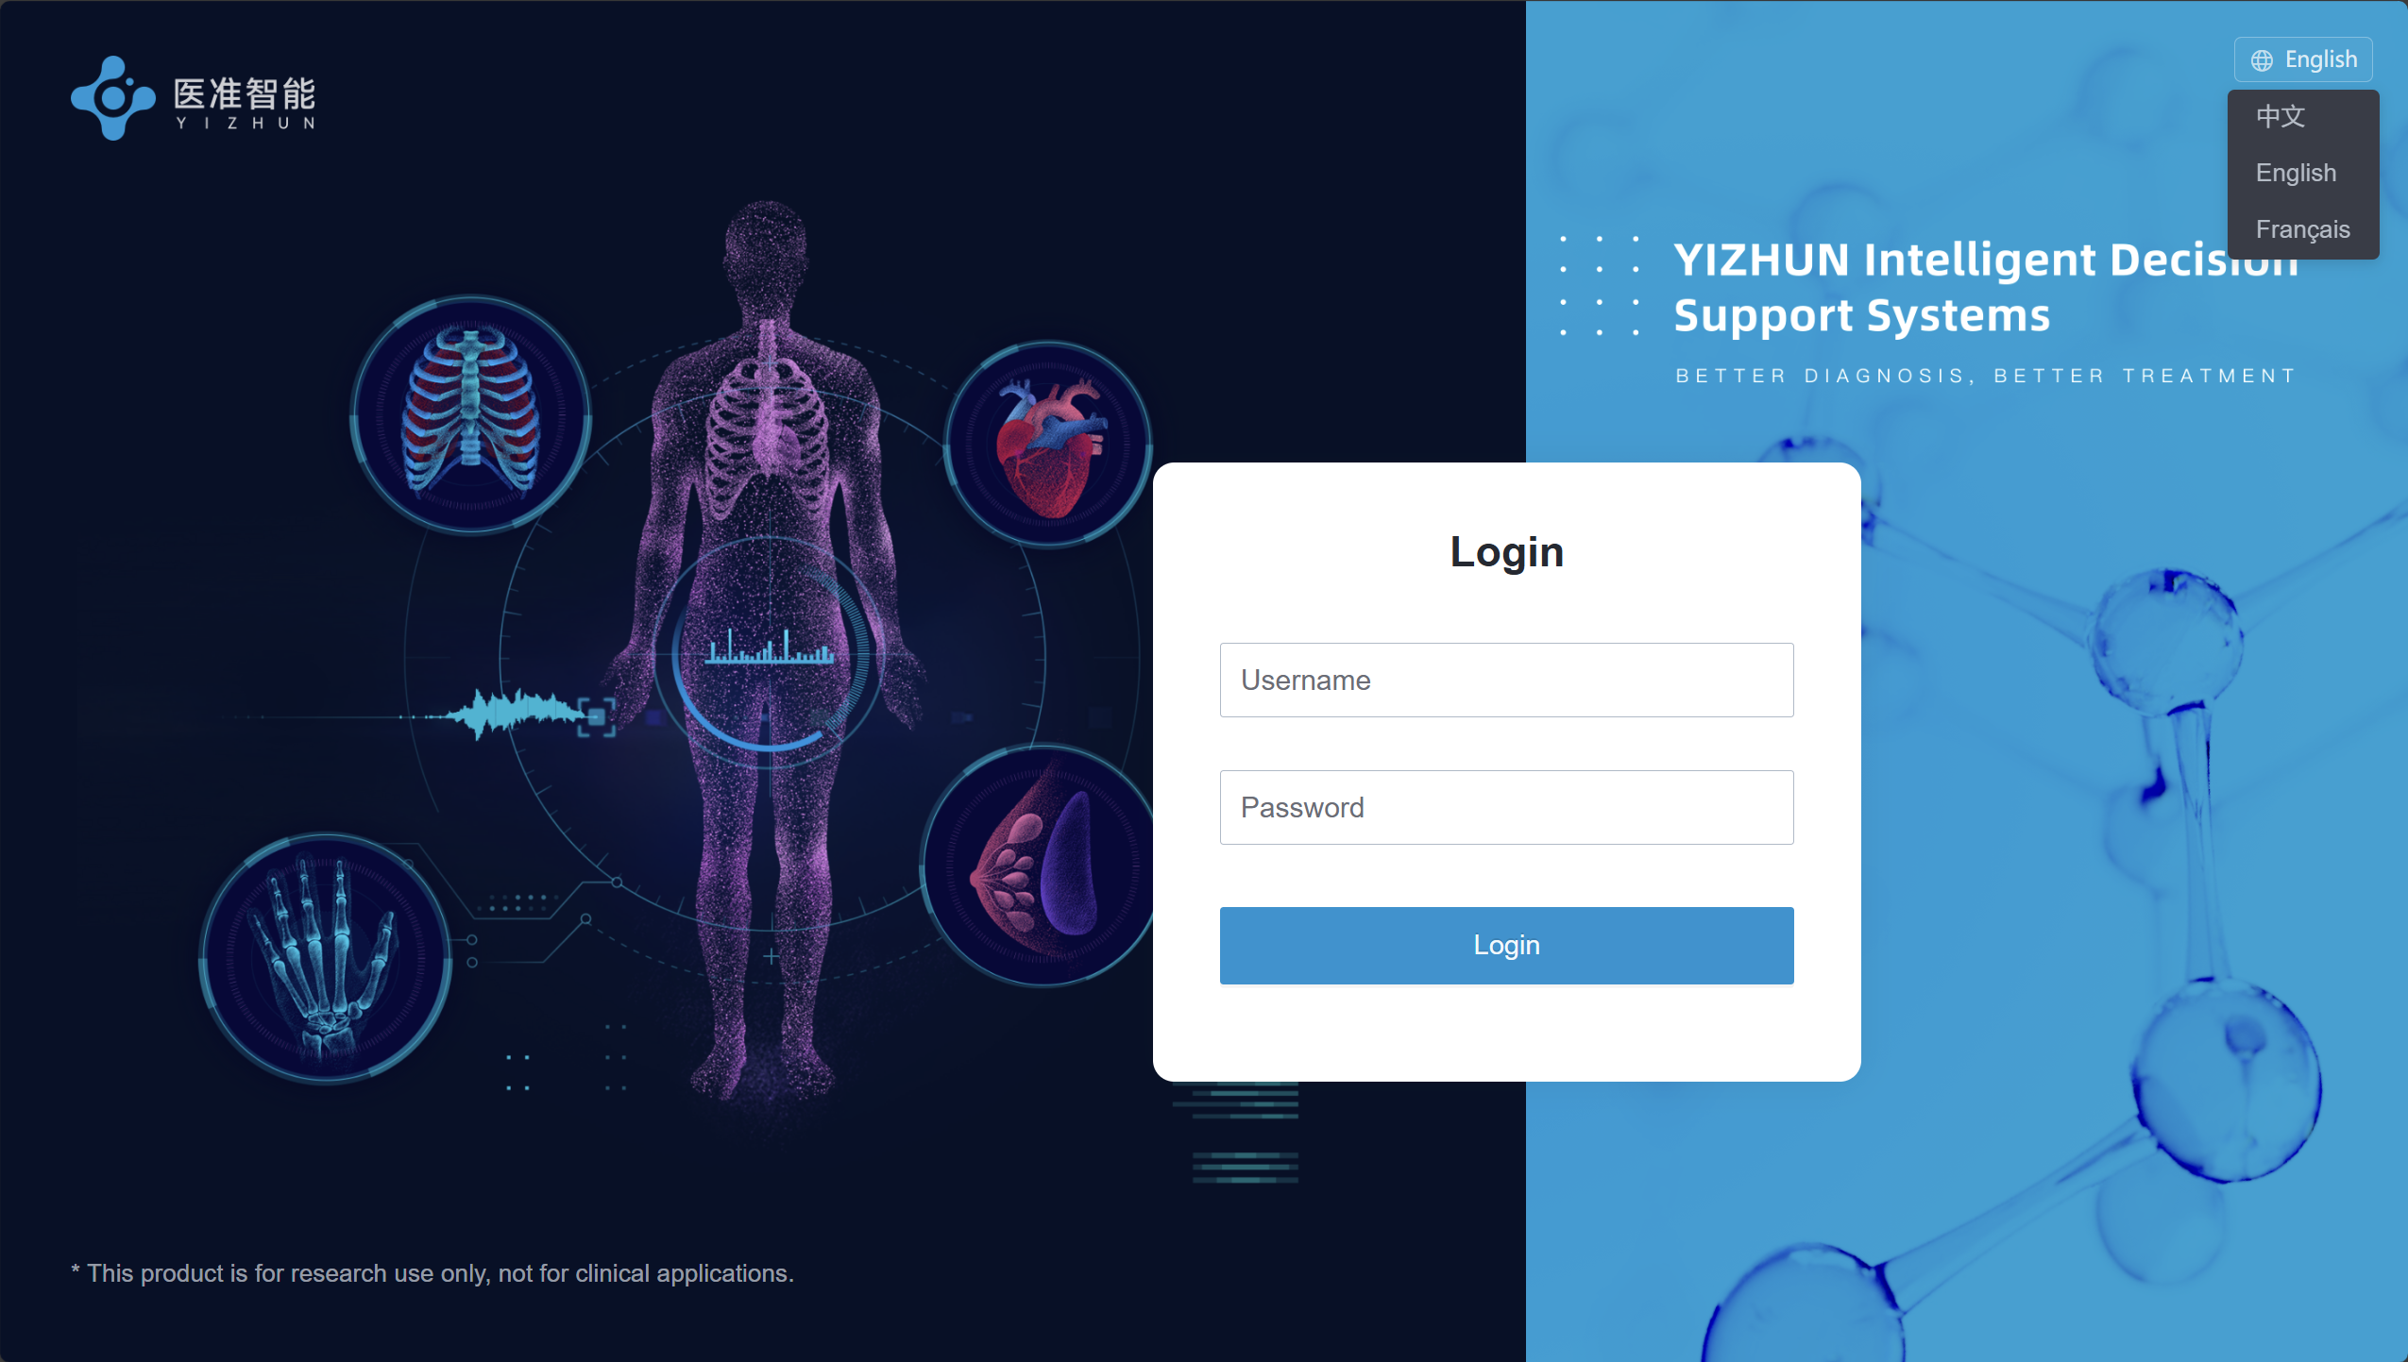
Step 1: Access the Platform
Visit Login Page - AI Imaging Platform
Contract the correspondence author for an account
Click this button to choose your preferred system language
Step 1. Access the System
Step 1. Access the System

Slide 3
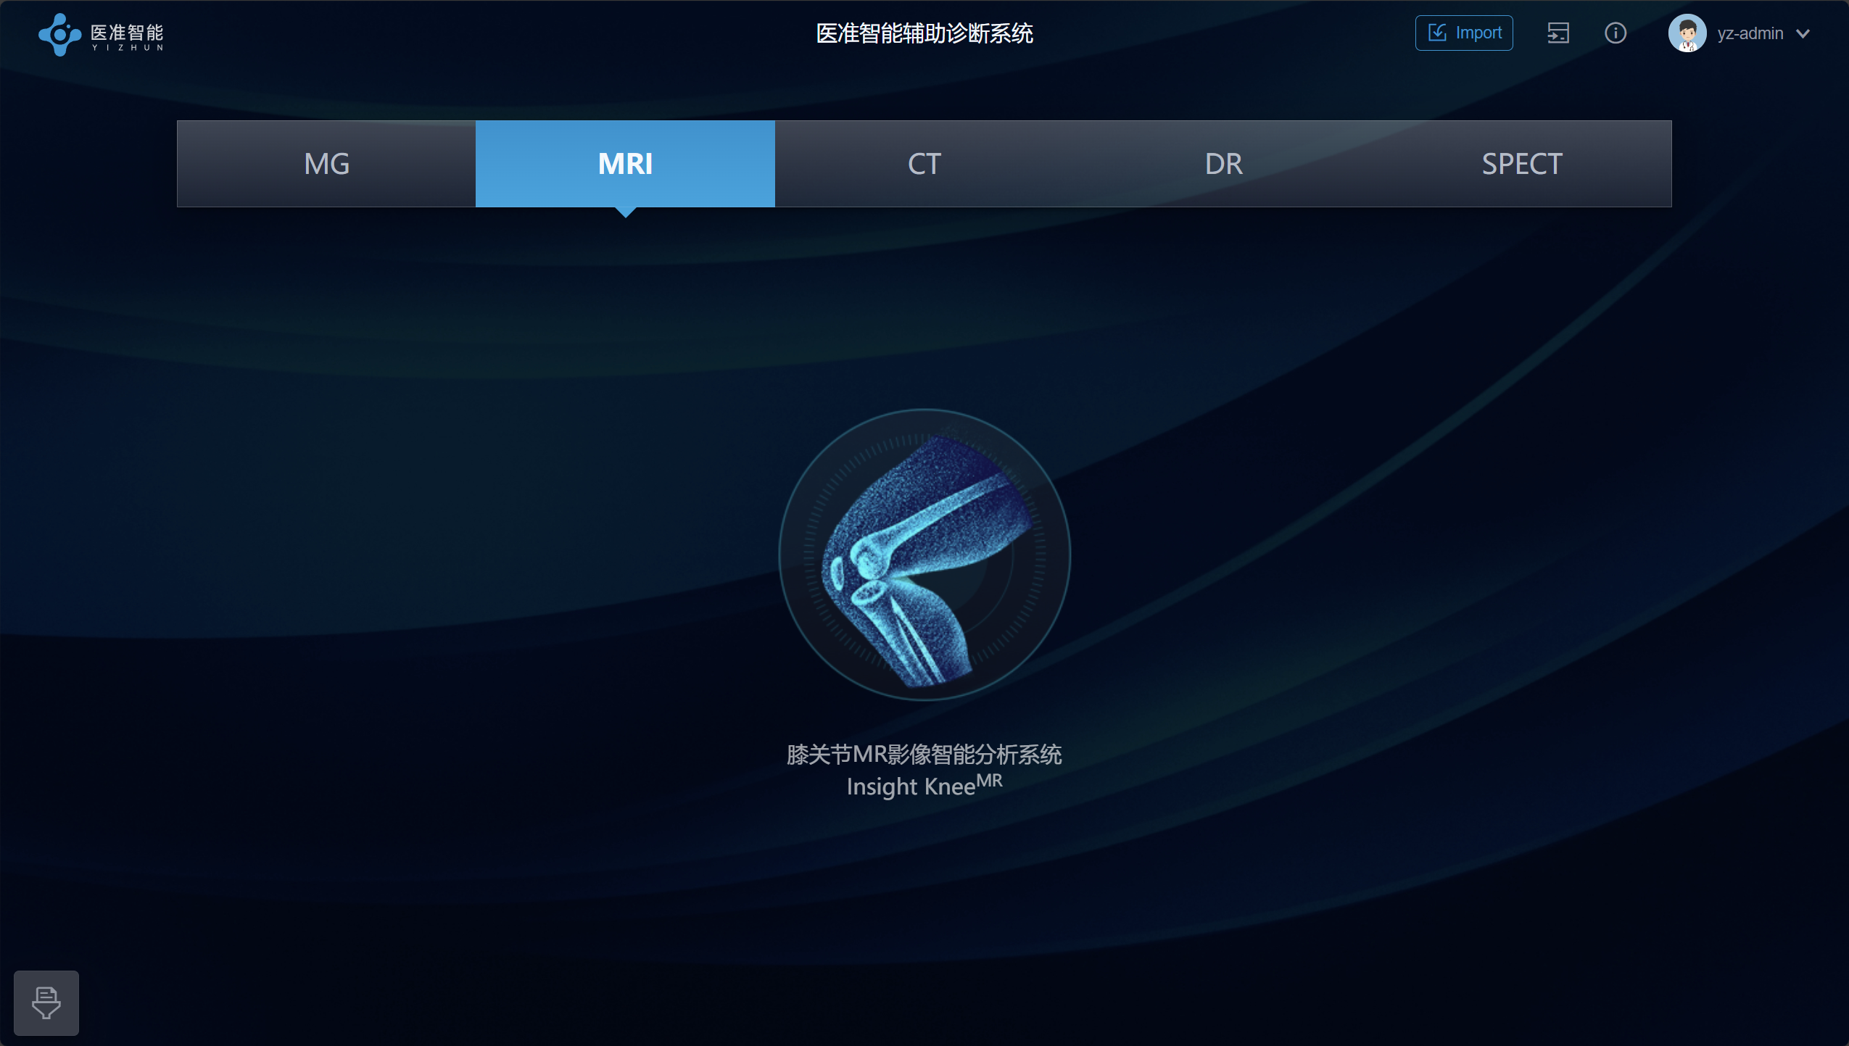
Step 2: Enter meniscus diagnosis system
Switch to MRI tab after logging in
Click the “knee joint icon” to enter meniscus lesion diagnosis system
Click to enter

Slide 4
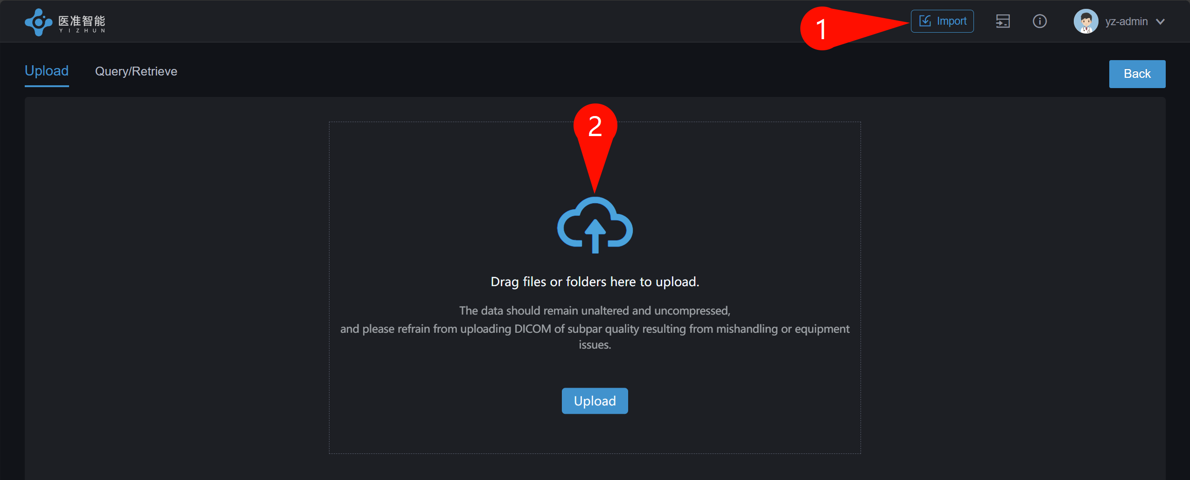
Step 3: Upload dicom files for diagnosis
Click the “Import” button in the top-right toolbar（①）
Click the cloud icon to open the file browser（②）
Choose the DICOM folder containing the study you want to diagnose.
Make sure the selected DICOM files include PD-SAG and PD-COR sequences (or equivalent protocols). For detailed sequence parameters, refer to the methodology section of the paper.

Slide 5
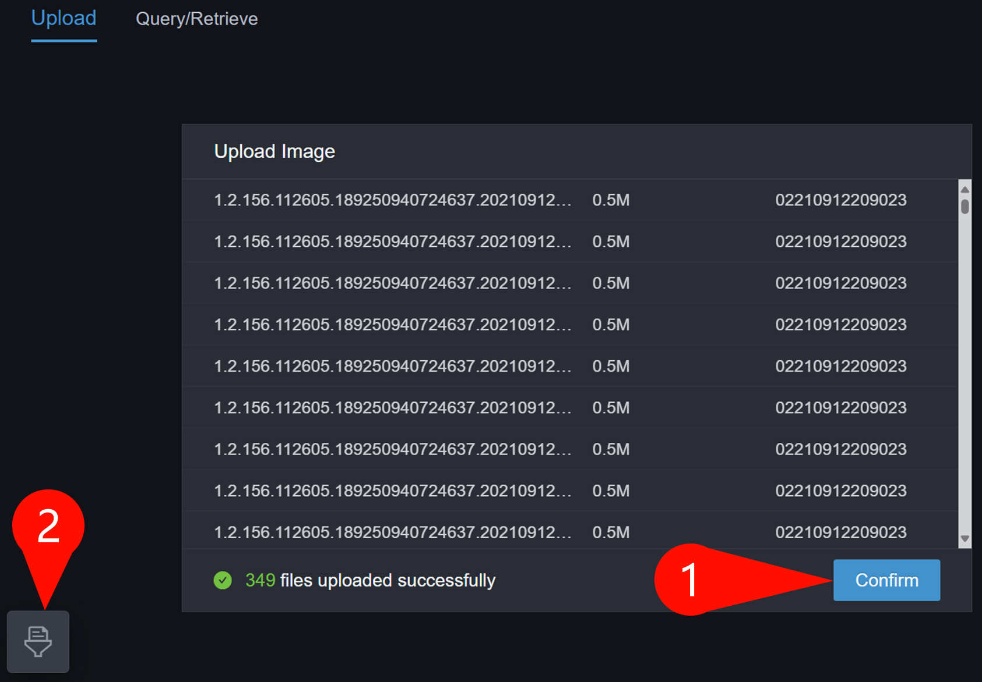
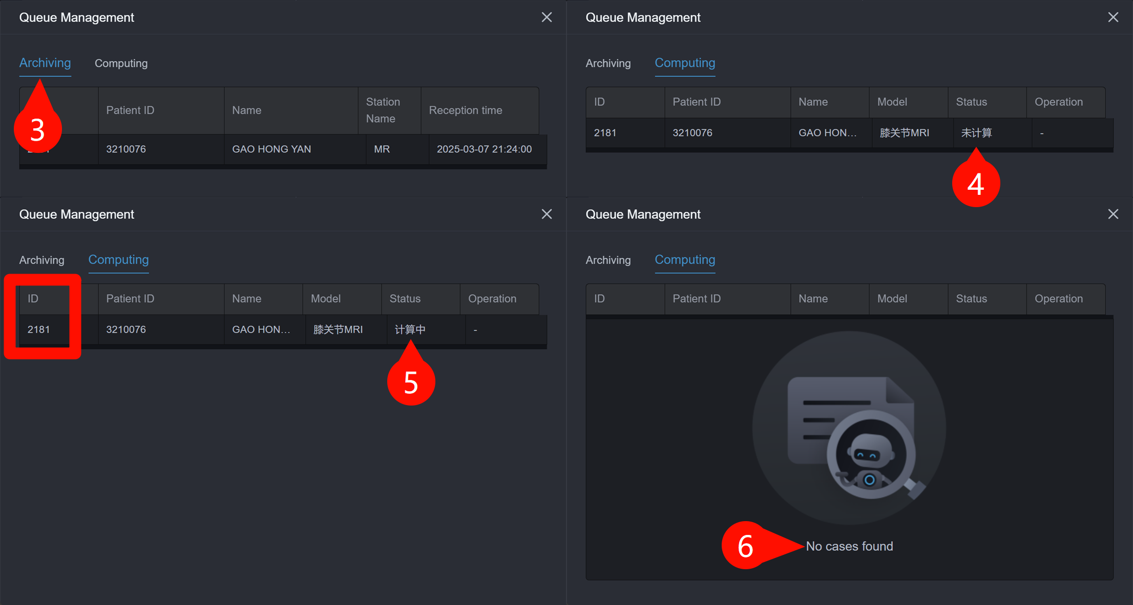
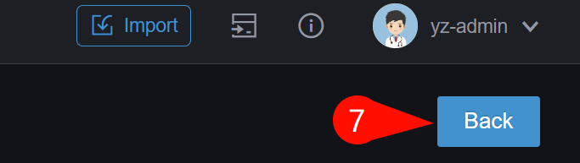
Step 3: Upload dicom files for diagnosis - Continued
Click the “Confirm” button (①) to start processing the uploaded study
Click the queue management button (②) in the bottom-right corner to view archiving & computing status:
Newly added studies will first appear in the “Archiving” tab (③) (may remains for a few seconds). Then switch to “Computing” tab to view computing status (④: about to compute; ⑤: computing). Remember the Study ID (red rectangle) displayed in the Computing tab for later result retrieval.
Computation is complete when the “Computing” tab shows “No Case Found“ (⑥).
Click Back button (⑦) on the top-right to go back to study table view

Slide 6
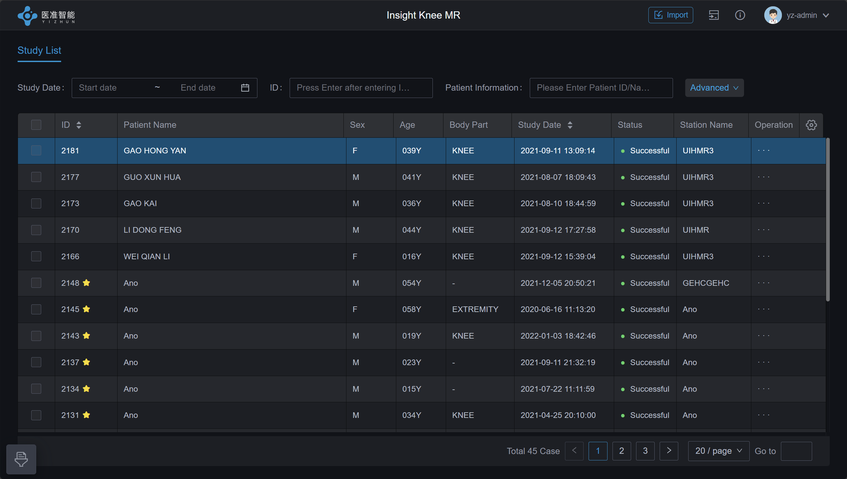
Step 4: Open Diagnostic Report Page
In the Study Table View, double-click the Study ID you uploaded earlier to open the Diagnostic Report Page.
Double-click to open diagnostic report page

Slide 7
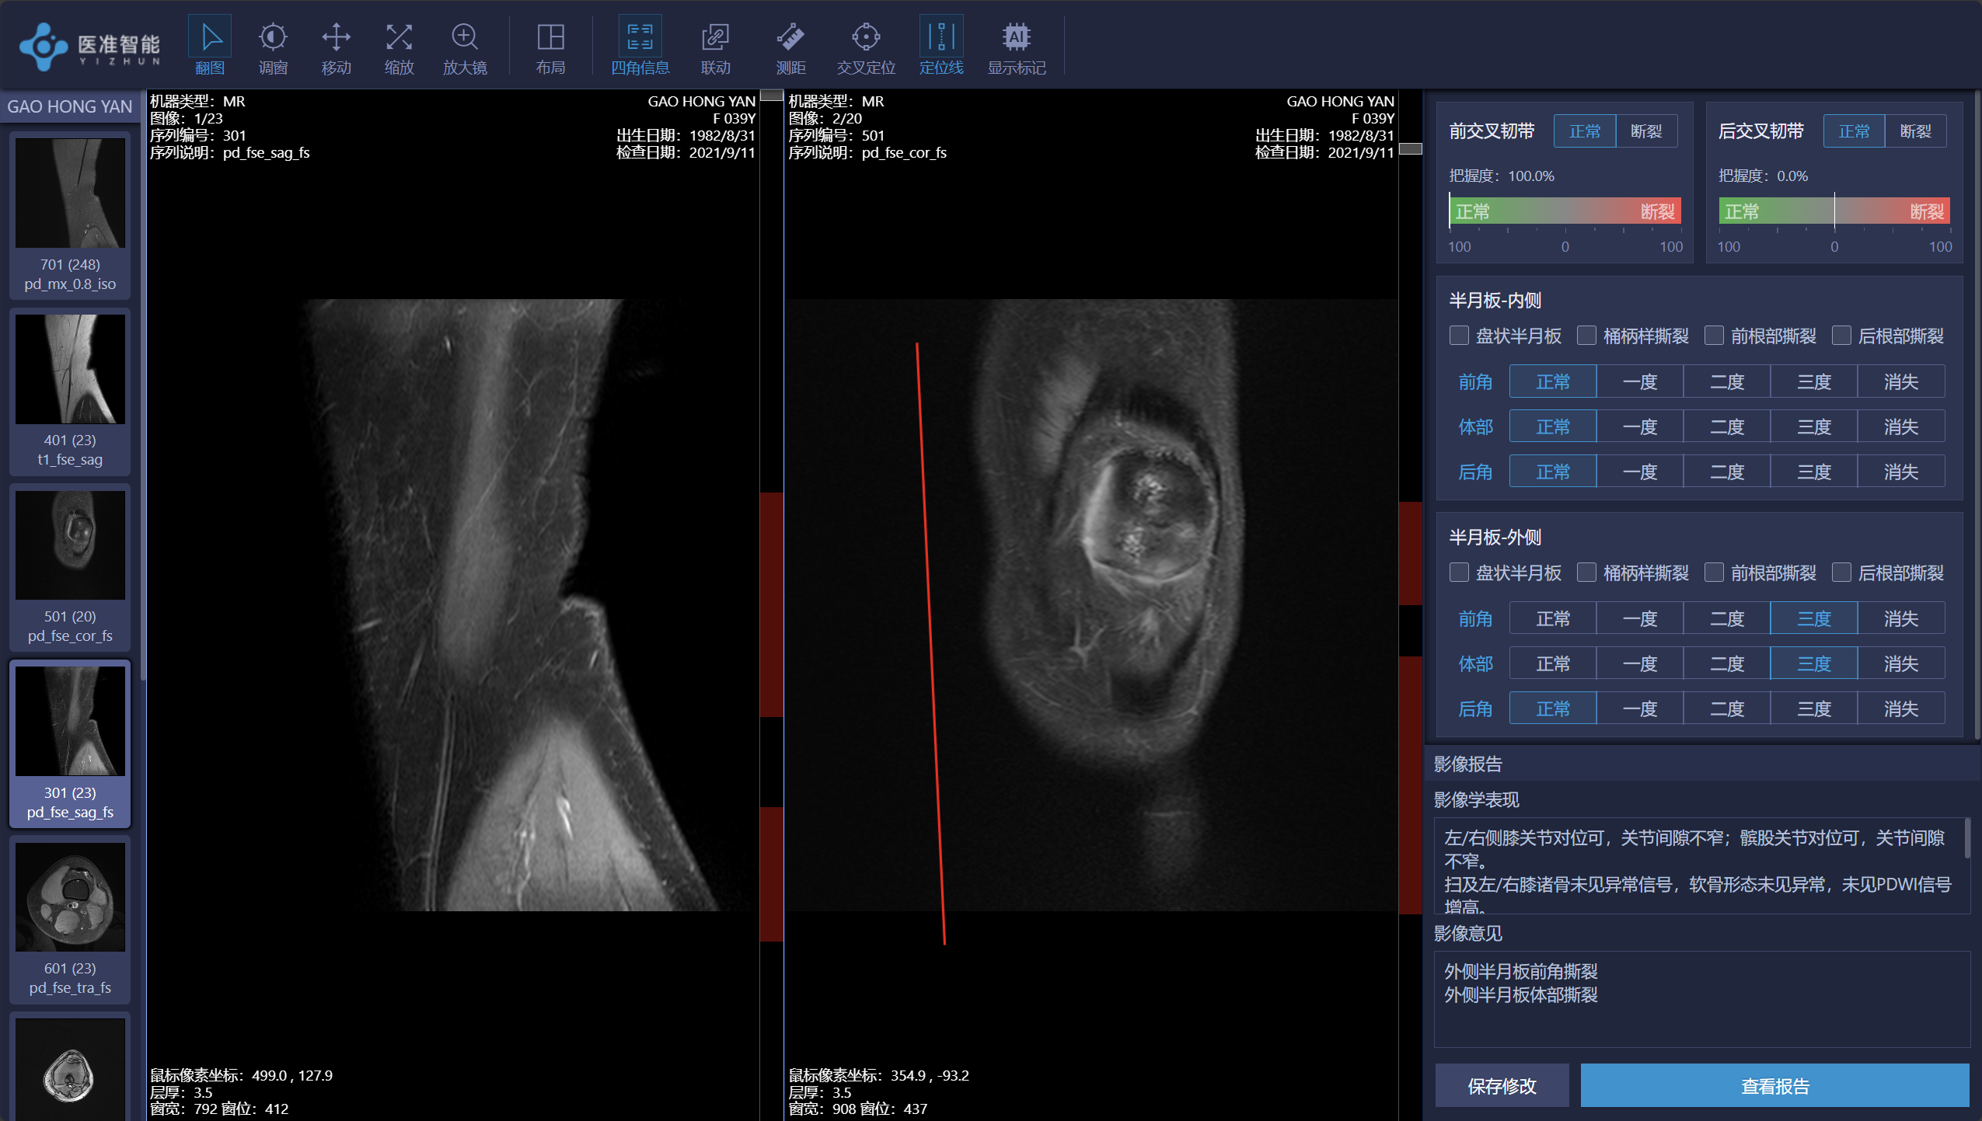
Step 5: Diagnostic Report Page
Click the thumbnail on the left to load the sequence into the active panel
Click the "View Report" button to access the diagnostic report.
Switch Slice
Pan
Magnifier
Corner Info
Synchronization
Cross Reference Line
Table: Terminology Translation
前交叉韧带 | Anterior Cruciate Ligament, (ACL)
后交叉韧带 | Posterior Cruciate Ligament,(PCL)
正常 | Normal
断裂 | Rupture
把握度 | Confidence Level
半月板-内侧 | Medial Meniscus
半月板-外侧 | Lateral Meniscus
盘状半月板 | Discoid Meniscus
桶柄样撕裂 | Bucket-Handle Tear
前根部撕裂 | Anterior Root Tear
后根部撕裂 | Posterior Root Tear
前角 | Anterior Horn
体部 | Body (meniscus)
后角 | Posterior Horn
一度 | Grade I
二度 | Grade II
三度 | Grade III
消失 | Absent
Show AI Annotations
Adjust Window
Zoom
Layout
Length Measurement
Cross Series Location
Panel1(active / clicked)
Panel2
View Report Button

